Slide 1
TASK 3: ENTERING/SOLVING A GIVEN WEBSITE USING BURPSUITE STEPS TO BE FOLLOWED: STEP 1:OPEN VMWARE WORKSTATION AND LOGIN TO KALI LINUX STEP 2: OPEN BURP SUITE CHECK WHETHER THE INTERCEPT IS ON .
PRAGYA PARAMITA DAS

Slide 2
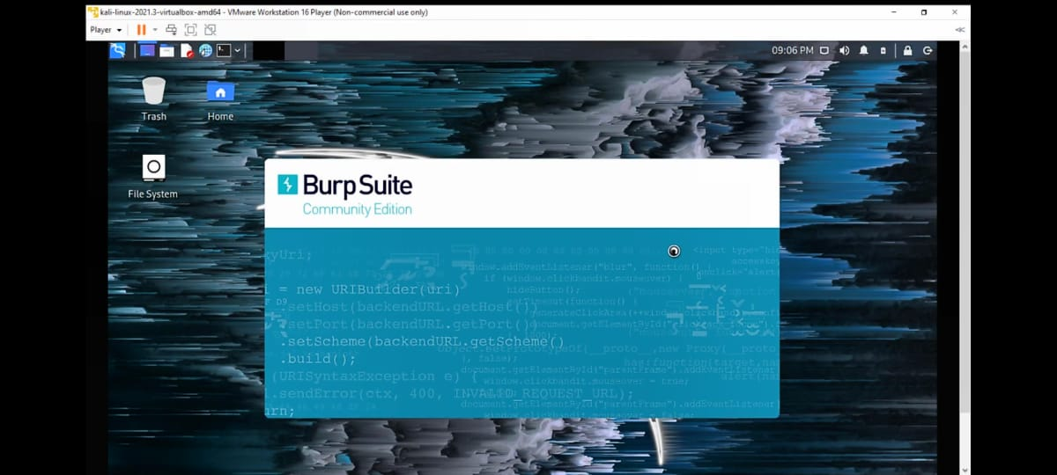

Slide 3
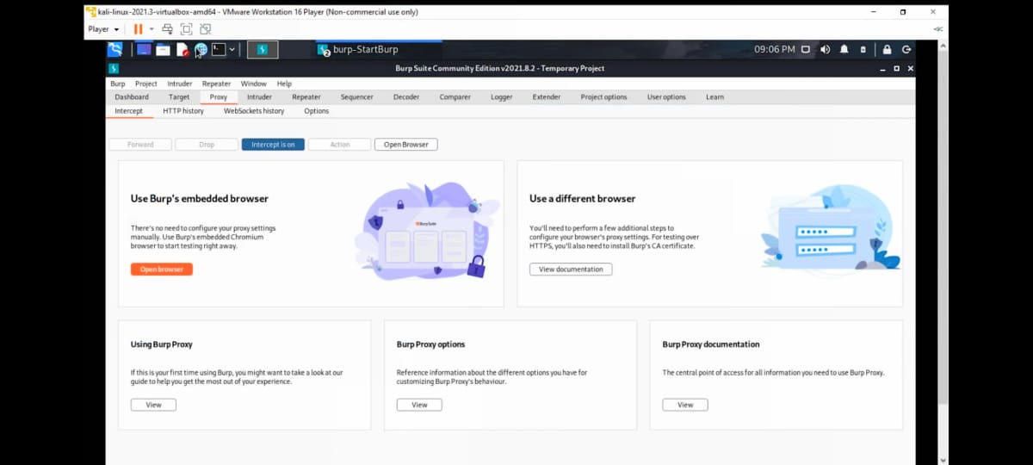

Slide 4
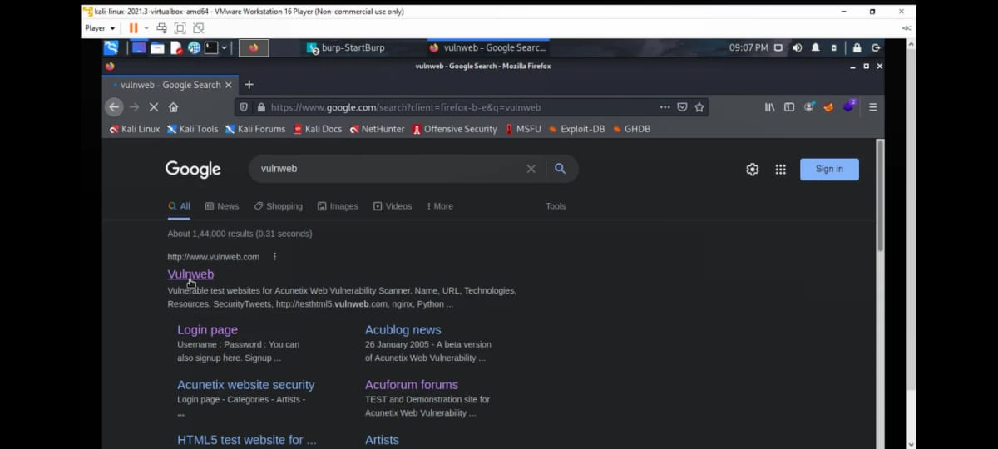
STEP 3:OPEN FIREFOR AND SEARCH FOR VULNWEB

Slide 5
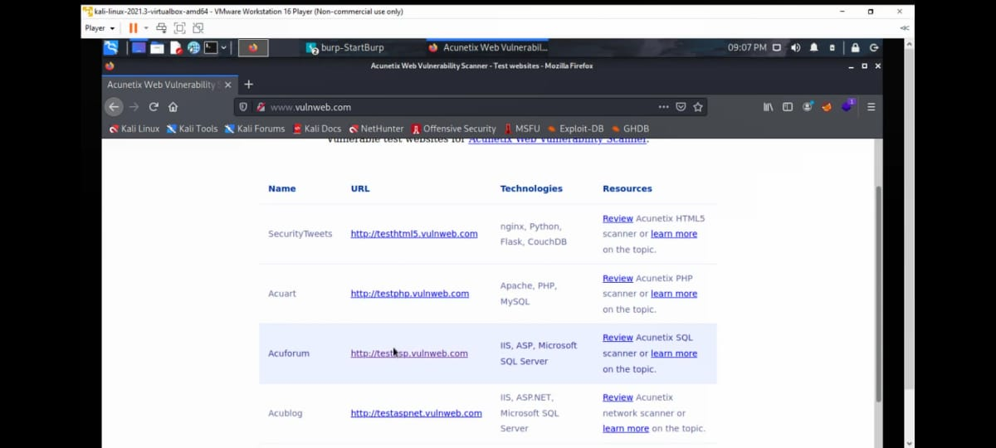
STEP 4: CLICK ON http://testasp.vulnweb.com the given interface will be opened

Slide 6
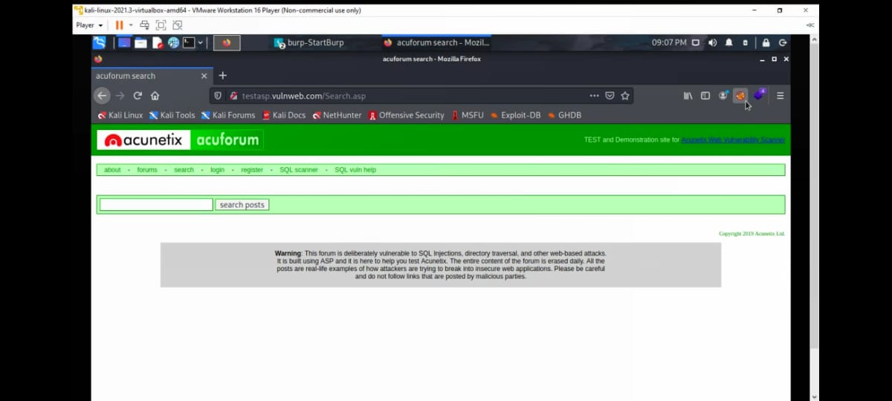
STEP 5: CLICK ON SEARCH BAR AND CLICK THE FOXYPROXY ON

Slide 7
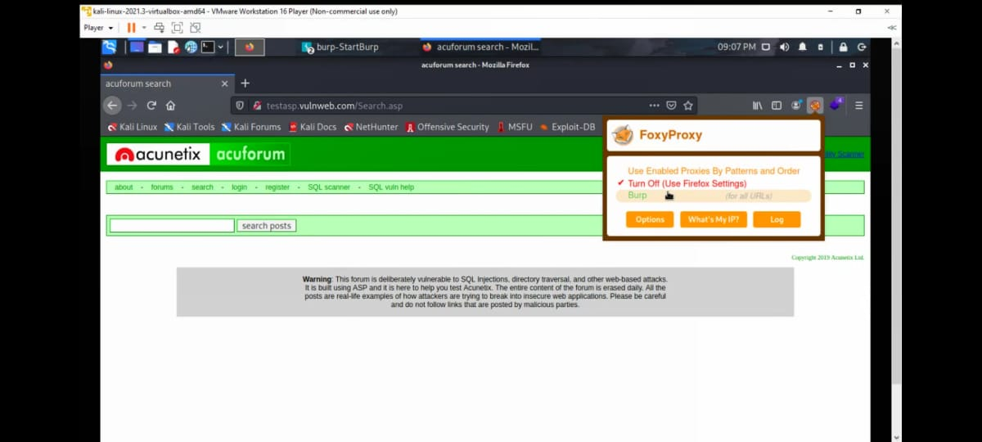
STEP 6: TRY TO ENTER ONE OF THE PAYLOADS SO THE REQUEST WILL BE SENT TO BURPSUITE

Slide 8
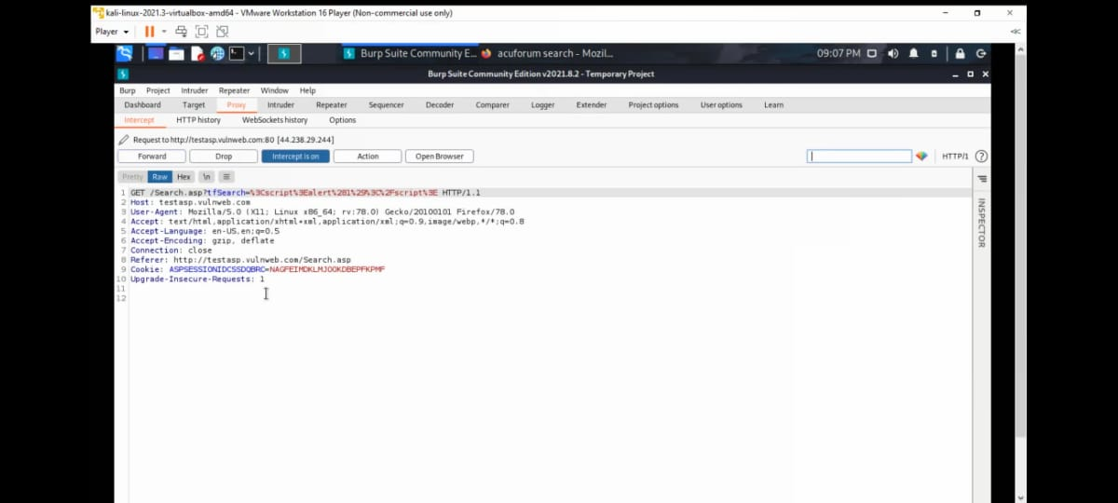
STEP 7: AFTER THE REQUEST COMES SEND IT TO INTRUDER AND FORWARD THE REQUEST

Slide 9
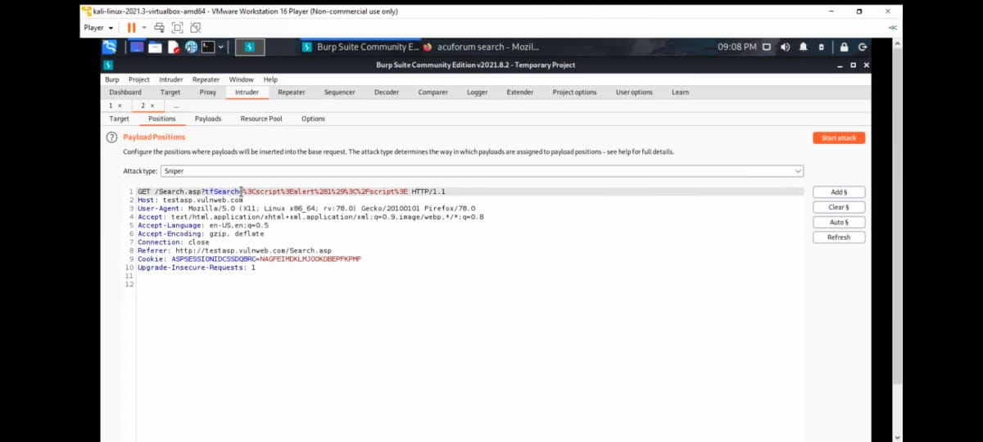
STEP 7:ADD THE PAYLOAD POSITION ONLY FOR THE REQUIRED PLACE.

Slide 10
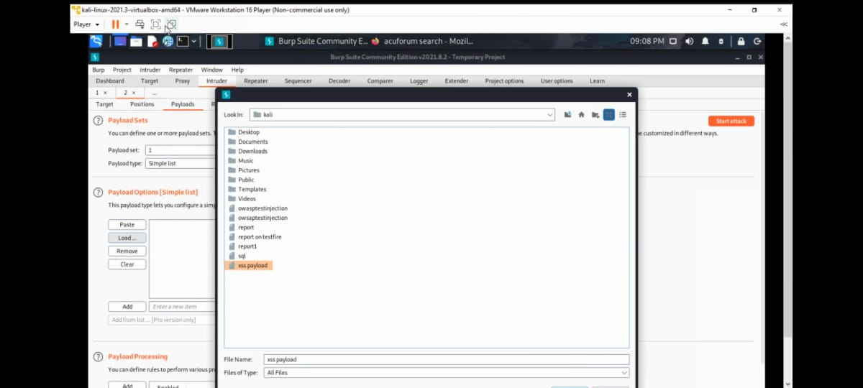
STEP 8: ADD THE XSS PAYLOADS ,WHICH CAN BE DOWNLOADED FROM www.github.com

Slide 11
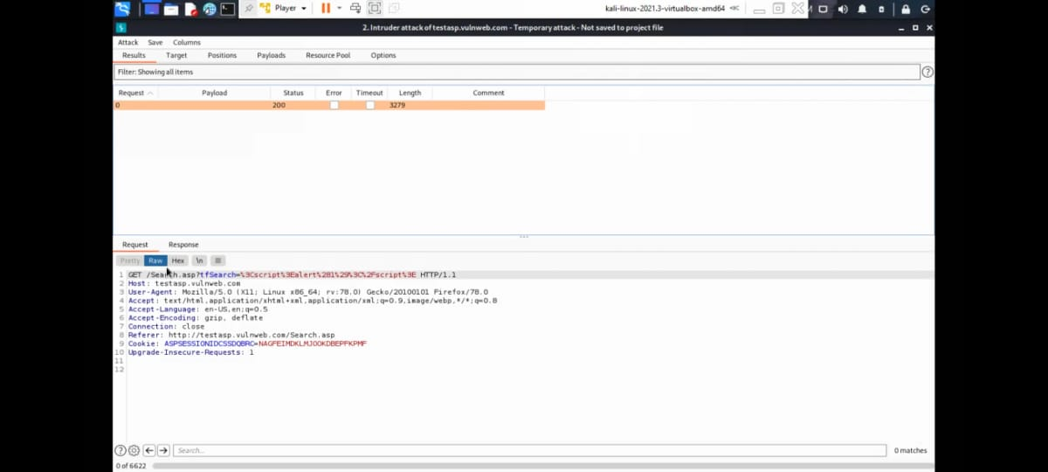
STEP 9: START THE ATTACK AND CHECK WHETHER THERE IS SUDDEN CHANGE IN LENGTH AND STATUS.

Slide 12
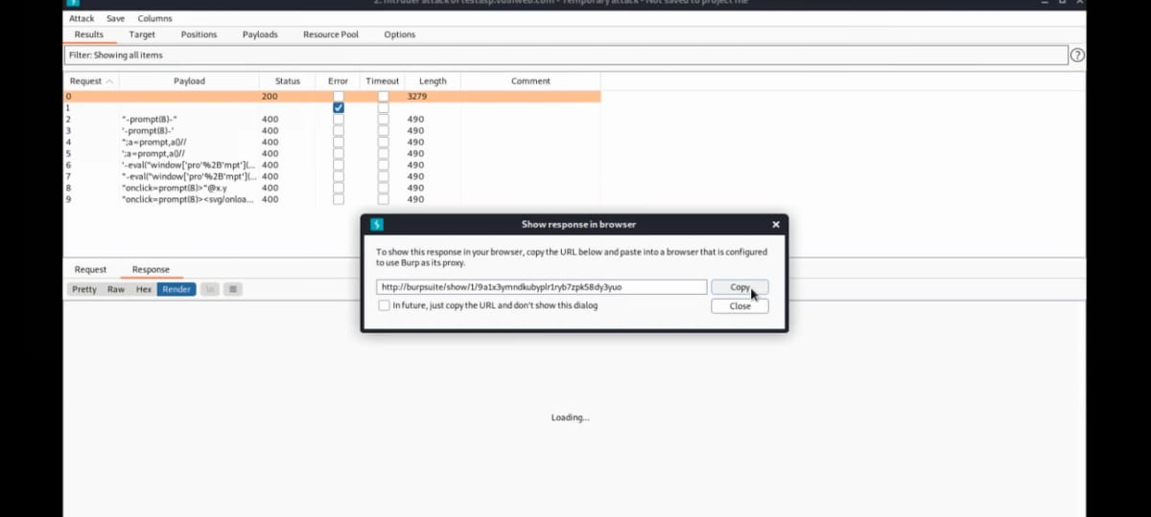
STEP 10:COPY THE URL TO SHOW THE RESPONSE FOR THE PAYLOD THAT HAS BEEN ACCEPTED

Slide 13
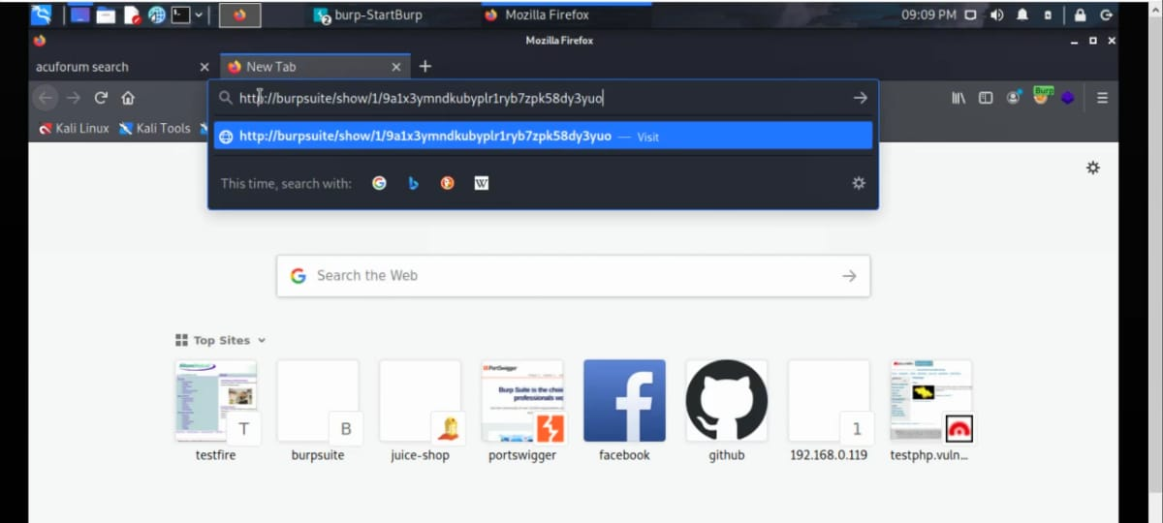
STEP 11:COPY THE URL AND SEARCH IT IN FIREFOX

Slide 14
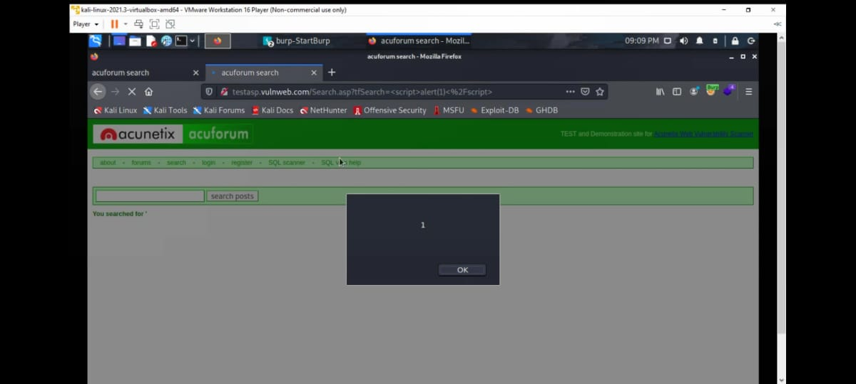
THE REQUIRED INTERFACE WILL BE IN THIS FORM.

Slide 15
